Slide 1
An Improved Wu-Manber Multiple Patterns Matching Algorithm
Author: Chouvalit Khancome、Pisit Chanvarasuth、Veera Boonjing
Presenter: Yi-Hsien Wu
Conference :
2013 10th International Conference on Information Technology: New Generations
Date: 2017/11/15
Department of Computer Science and Information Engineering
National Cheng Kung University, Taiwan R.O.C.
Notes:
1

Slide 2
Outline
Introduction
Proposed Scheme
Results and Analysis
Conclusion

Slide 3
Introduction
The new approach uses two related hashing table for storing the target patterns.
Including, the shift table is used to recognize the shift value for a new window search .
In the searching phase, the matching method hashes one time or twice in the first hashing table if there is no pattern overlapping or twice in both hashing tables
if there is only one or more pattern overlapping.
Notes:
近期因為ruleset size快速成長，因此ruleset複雜度造成一般封包分類方法memory表現很差
Swintop是一種將ruleset去分類的方式

Slide 4
Proposed Scheme
Firstly, let lmin be the minimum length of patterns .
Definition 1.
The hashing table, which consists of two columns : ⅀ and the shifting values
⅀ is the single alphabet which appear in P.
The shifting value is an integer number which is used for setting the new window search.

Slide 5
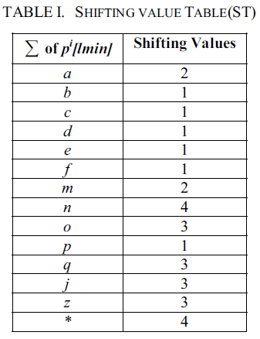
Proposed Scheme (Preprocessing)
Example : The ST of P={aaba, aabab, aababc, aababcd, aababcde, abcb, zmnd, qope, jmqfm }
* is the other characters that
are not appeared in patterns.

Slide 6
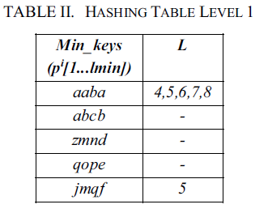
Proposed Scheme(Preprocessing)
Definition 2. The hashing table (called the hashing table level 1 denoted by HL1), which stores the prefix of all patterns that the number of characters equal the minimum length of patterns (Min_keys) and the lists of patterns overlapping lengths (L) .
P={aaba, aabab, aababc, aababcd, aababcde,
abcb, zmnd, qope, jmqfm }

Slide 7
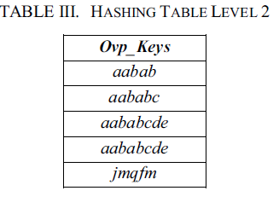
Proposed Scheme(Preprocessing)
Definition 3. The hashing table, which stores the patterns that are overlapping in HL1, is called the overlapping patterns table (denoted by HL2);
where Ovp_Keys is the column, stored the patterns which are overlapped from HL1 and their lengths are longer than patterns in HL1.
P={aaba, aabab, aababc, aababcd, aababcde,
abcb, zmnd, qope, jmqfm }

Slide 8
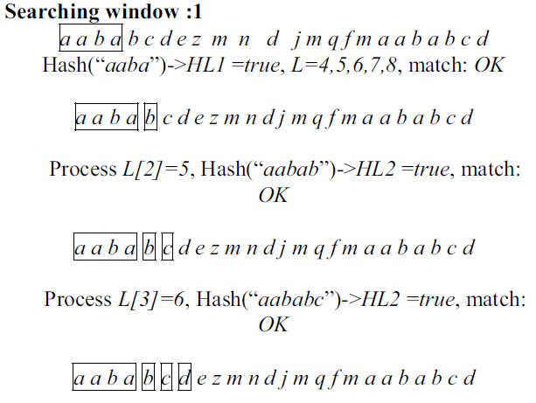
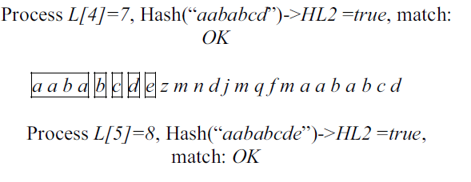
Proposed Scheme(Searching)
P={aaba, aabab, aababc, aababcd, aababcde, abcb, zmnd, qope, jmqfm}
Text T= aababcdezmndjmqfmaababcd

Slide 9
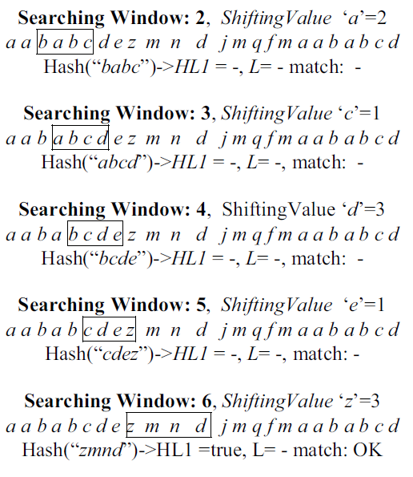
Proposed Scheme(Searching)

Slide 10
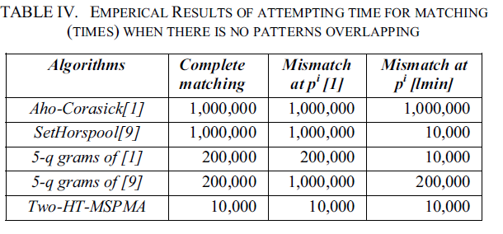
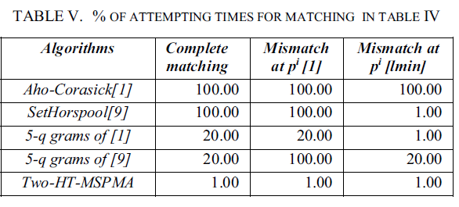
Results and Analysis
In our empirical results, the given text of 1,000,000 characters and the minimum length of all patterns to be matched 100 characters were assumed.

Slide 11
Conclusion
The multiple-string pattern matching employing two hashing tables was presented.
This approach takes O(|P|) time and space preprocessing where |P| is the sum of lengths in P.
The search takes O(|t||P|) in the worst case, O(|t|) in an average case, and O(|t|/lmin) in the best case scenario; where |t| is the length of text T and lmin is the minimum length of patterns.
As shown in our empirical results, the attempting times were less than of the traditional algorithms especially in the case of a very long minimum pattern length.

